Slide 1
Tasks, async/await and multithreading quiz
David Omid

Slide 2
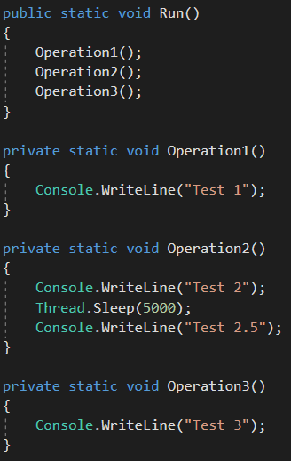
Question 1
What will be the output of the Run method?
Test 1 Test 2 Test 3
Test 1 Test 2 Test 2.5 Test 3
Test 1 Test 2
None of the above.

Slide 3
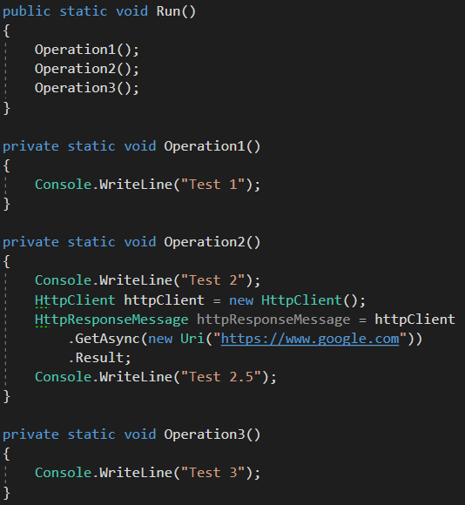
Question 2
What will be the output of the Run method?
Test 1 Test 2 Test 2.5 Test 3
Test 1 Test 2
Test 1 Test 2 Test 3
None of the above.

Slide 4
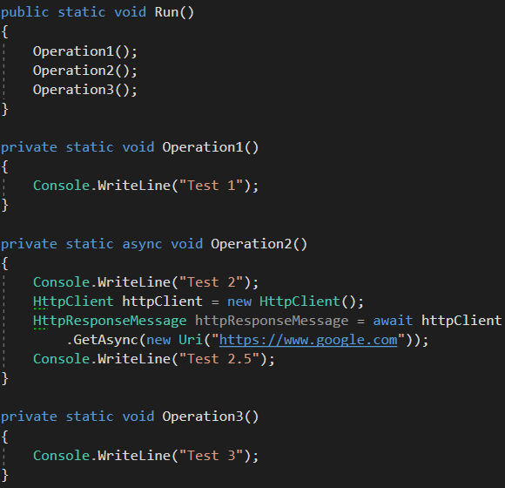
Question 3
What will be the output of the Run method?
Test 1 Test 2 Test 3
Test 1 Test 2
Test 1 Test 3
Test 1 Test 2 Test 2.5 Test 3
None of the above.

Slide 5
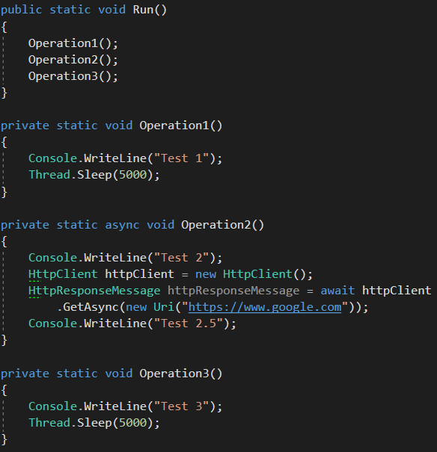
Question 4
What will be the output of the Run method?
Test 1 Test 2 Test 3
Test 1 Test 2
Test 1 Test 3
Test 1 Test 2 Test 2.5 Test 3
None of the above.

Slide 6
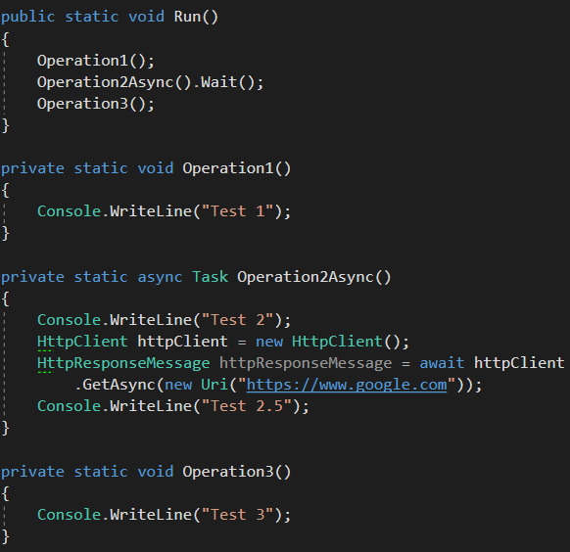
Question 5
What will be the output of the Run method?
Test 1 Test 2 Test 3
Test 1 Test 2
Test 1 Test 3
Test 1 Test 2 Test 2.5 Test 3
None of the above.

Slide 7
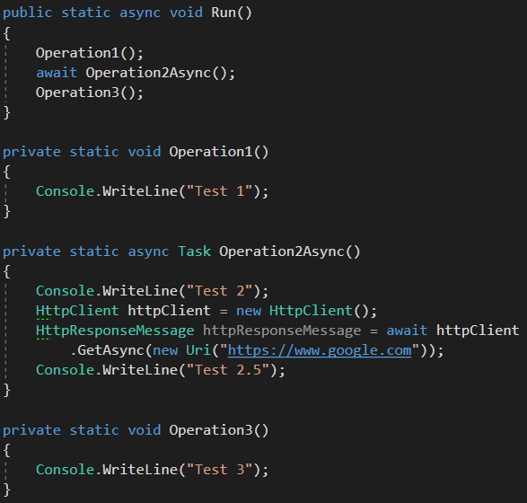
Question 6
What will be the output of the Run method?
Test 1 Test 2 Test 3
Test 1 Test 2
Test 1 Test 3
Test 1 Test 2 Test 2.5 Test 3
None of the above.

Slide 8
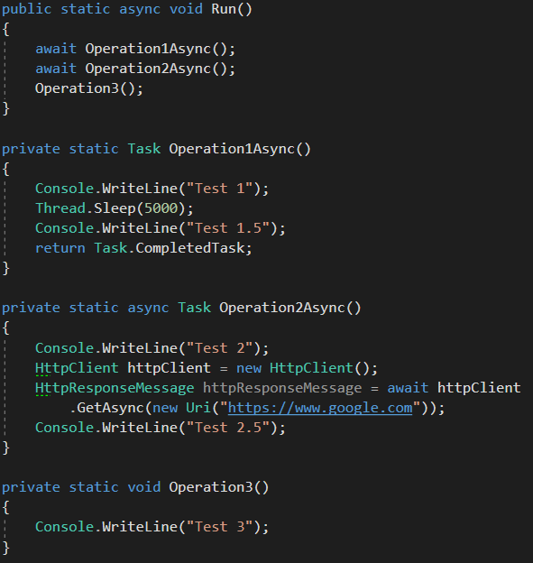
Question 7
What will be the output of the Run method?
Test 1 Test 1.5
Test 1 Test 1.5 Test 2
Test 1 Test 1.5 Test 2 Test 3
Test 1 Test 1.5 Test 2 Test 2.5 Test 3
None of the above.

Slide 9
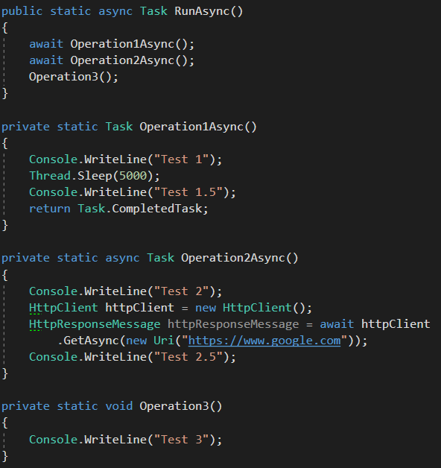
Question 8
What will be the output of the RunAsync method?
Test 1 Test 1.5
Test 1 Test 1.5 Test 2
Test 1 Test 1.5 Test 2 Test 3
Test 1 Test 1.5 Test 2 Test 2.5 Test 3
None of the above.

